Slide 1
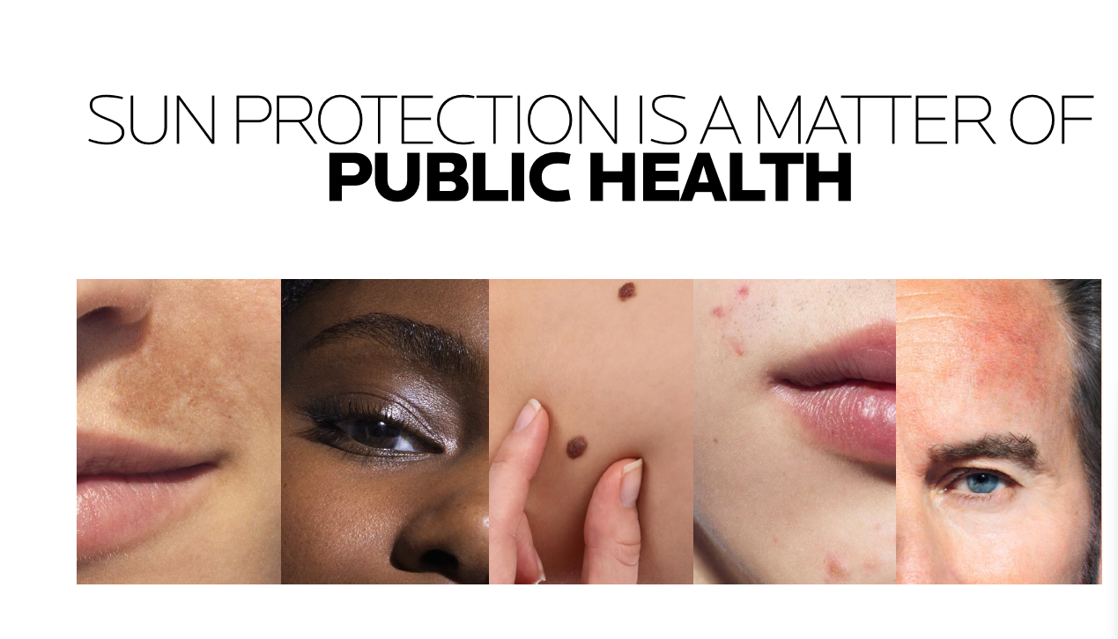


Optimising Care: Pre and Post Treatment Strategies for Actinic Keratosis in your Skin Cancer Practice
Presenting Speaker: Dr John O’Byren
Proudly Sponsored by
Reference: 1. John O’Bryen, et al. Pre-care and After-care for the Treatment of Actinic Keratosis: An Australian and New Zealand perspective [unpublished, draft]. 2024.

Slide 2
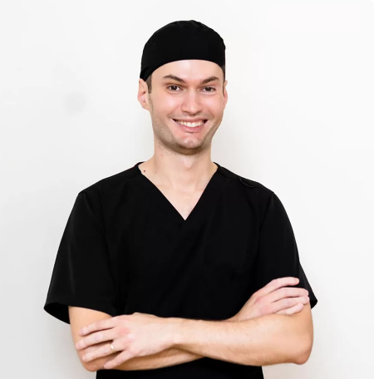

DR JOHN O’BRYEN
Skin cancer doctor, Dr John O’Bryen, is a specialist general practitioner who has done further training in skin cancer medicine and surgery. He has his own clinic called Body Scan Skin Cancer Clinic in Buderim, Sunshine Coast. Dr O’Bryen performs skin cancer checks and is trained in the surgical and non-surgical management of skin cancers, including the use of skin flaps and grafts when required. He works closely with local surgeons, dermatologists and radiation oncologists to achieve the best outcomes for his patients. He advocates for his patients and ensures they are listened to and thoroughly examined. Outside of the consult room, he teaches medical students, volunteers as a helpline panellist for Doctors Health Queensland, and has featured as a guest speaker at charity events. Dr O’Bryen has numerous publications and is a peer reviewer for the Australian Journal of General Practice.
Qualifications
BSc (UQ) MBBS (UQ) FRACGP-RG
Accredited Skin Cancer Doctor (SCCA)
Advanced Clinical Certificate of Dermoscopy
Advanced Clinical Certificate of Skin Cancer Medicine and Surgery
Professional Diploma of General Dermatology (HealthCert)
Queensland Rural Generalist advanced skill Dermatology
Senior Lecturer Griffith University and The University of Queensland
Just finished AFRACMA, undertaking UQ MMed (Skin Cancer)
Affiliations and disclosure of interests – honoraria from L’Oreal Group

Slide 3
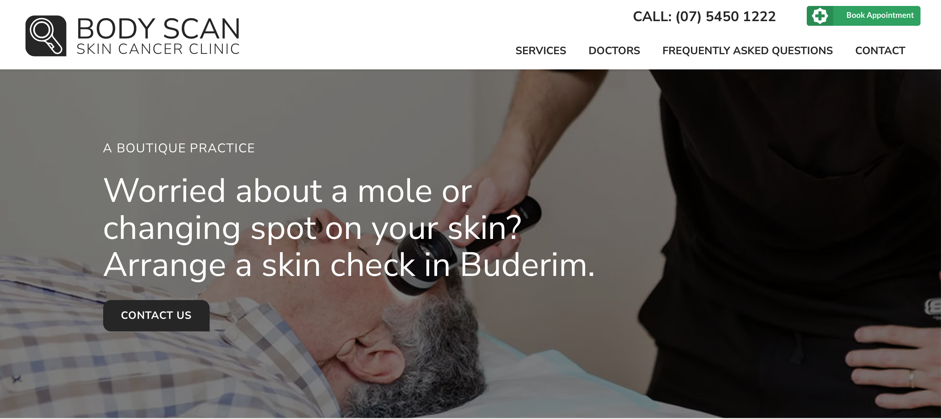

Slide 4
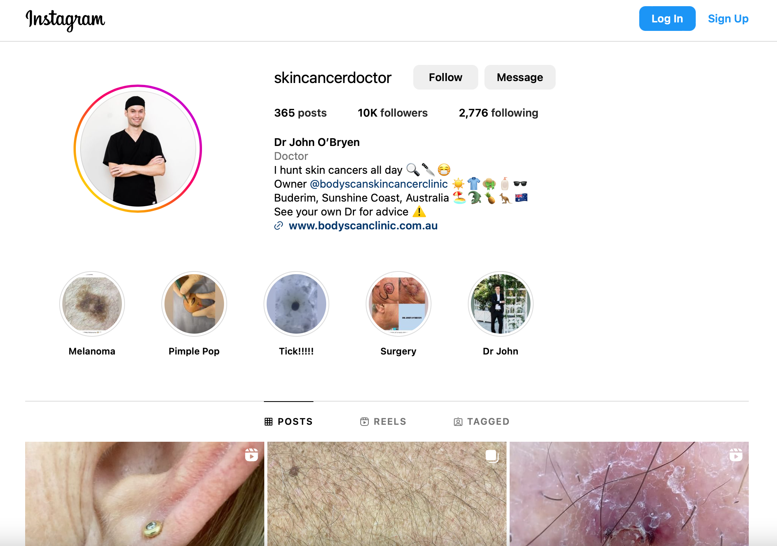

Slide 5
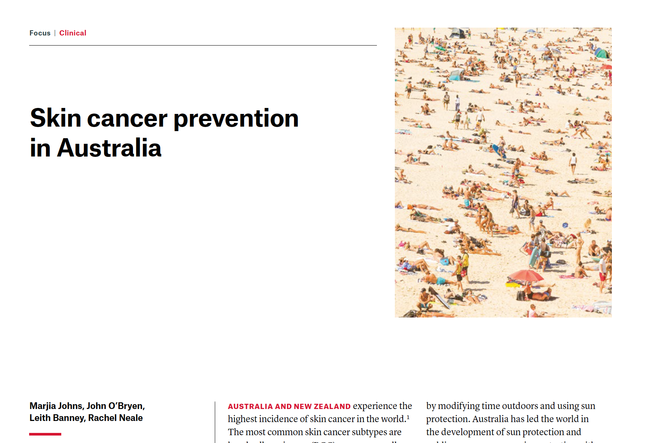
Review article published this August in the Australian Journal of General Practice (open access)
KEY POINTS
Slip, slop, slap, seek, slide
SunSmart App
Daily sunscreen
When to recommend chemoprophylaxis with oral B3 and oral acitretin

Slide 6
AUSTRALIA AND NEW ZEALAND LOCAL AK ADVISORY BOARD
MEMBERS OF THE BOARD
DR JOHN O'BRYEN​, GP, BODY SCAN SKIN CANCER CLINIC, QLD, AU​
PROF PASCALE GUITERA​, DERMATOLOGIST, SYDNEY MELANOMA DIAGNOSTIC CENTRE, RPA HOSPITAL, AND MELANOMA INSTITUTE OF AUSTRALIA, NSW, AU
DR RYAN DE CRUZ, DERMATOLOGIST, SOUTHERN DERMATOLOGY, VIC, AU​
DR AJ (ADRIAN) SEINE​, DERMATOLOGIST, SKIN CENTRE, TAURANGA, NZ​
DR LOUISE REICHE, DERMATOLOGIST, KAURI HEALTH CENTRE, PALMERSTON NORTH, NZ​
DR AARON BOYCE, DERMATOLOGIST, TOWNSVILLE UNIVERSITY HOSPITAL, QLD, AU​
DR PHILIP TONG​, DERMATOLOGIST, DERMATOLOGY JUNCTION, NSW, AU​
DR SOLANGE GREEN​, GP, THE MELANOMA CENTRE, QLD, AU​
DR JEREMY HUDSON​, GP, NORTH QUEENSLAND SKIN CENTRE, QLD, AU​
MR JIM SIDEROV​, PHARMACIST, AUSTIN HEALTH, VIC, AU

Slide 7
Summary
AWAITING PUBLICATION
 | Field-directed treatments
Pre-care Remove makeup. Wash the area with a gentle soap-free, fragrance free cleanser. Dry thoroughly. Consider curettage or the application of keratolytic agent for hyperkeratotic lesions. | After-care Use a gentle cleanser with a pH ≈ 5 that is acceptable for all skin types. Consider a barrier repair cream such as soothing balm with panthenol. Consider an emollient that is fragrance free with a hydrating formulation. Sun protection Use sun protection everyday and minimise exposure at peak UV rating. Sun protection should be used when outdoors or near a window. Use clothing with a high UPF that covers the body from wrist to ankle. Wear sunglasses and a wide brimmed hat. Apply sunscreen with SPF 50+ UVA/UVB protection on all exposed areas. Apply daily on all exposed sites and use an appropriate amount of sunscreen. Use clothing on any sites that are inflamed or broken. Do not use sunscreen on these sites. Reapply sunscreen twice daily. Apply every two hours when skin is exposed to water, or if in the sun for prolonged periods of time, or if sweating excessively. | Prevention of Relapse Consider the use of oral nicotinamide in the morning and evening if patient is at high risk for developing skin cancer or frequent relapse of skin cancer. Know when to refer to a dermatologist for oral acitretin. Consider the use of topical retinoids for chronic actinic damage reversal. Sun protection Use sun protection everyday and minimise exposure at peak UV rating. Sun protection should be used when outdoors or near a window. Use clothing with a high UPF that covers the body from wrist to ankle. Wear sunglasses and a wide brimmed hat. Apply sunscreen with SPF 50+ UVA/UVB protection on all exposed areas. Apply daily on all exposed sites and use an appropriate amount of sunscreen. Reapply sunscreen twice daily. Apply every two hours when skin is exposed to water, or if in the sun for prolonged periods of time, or if sweating excessively.
Lesion-directed treatments | Lesion-directed treatments
Pre-care Consider curettage for hyperkeratotic lesions | After-care Follow the same guidelines as for field-directed treatments including sun protection. Cryotherapy can result in skin blistering and so sunscreen and other topical products should be avoided in those areas until the skin is repaired. | Prevention of Relapse Follow the same guidance as for field-directed treatments including sun protection. Field treatment should be considered if relapse occurs.

Slide 8
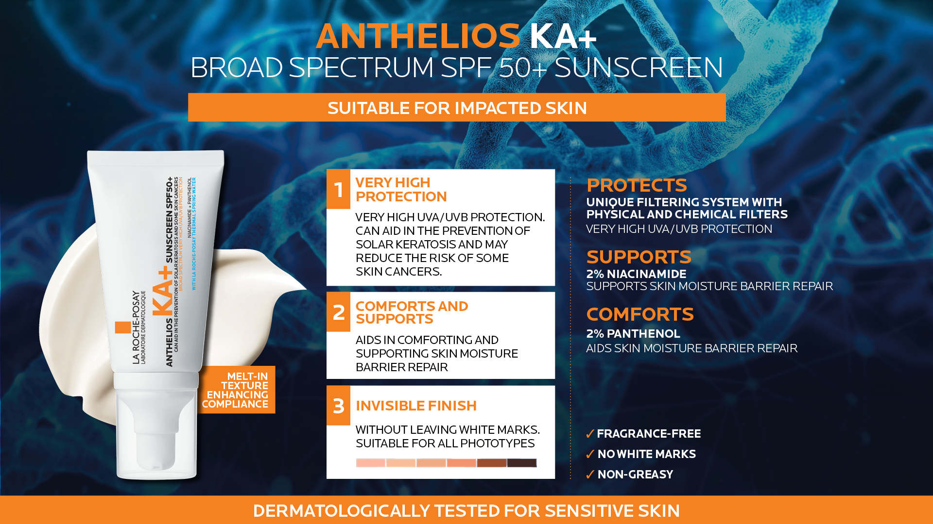

Slide 9
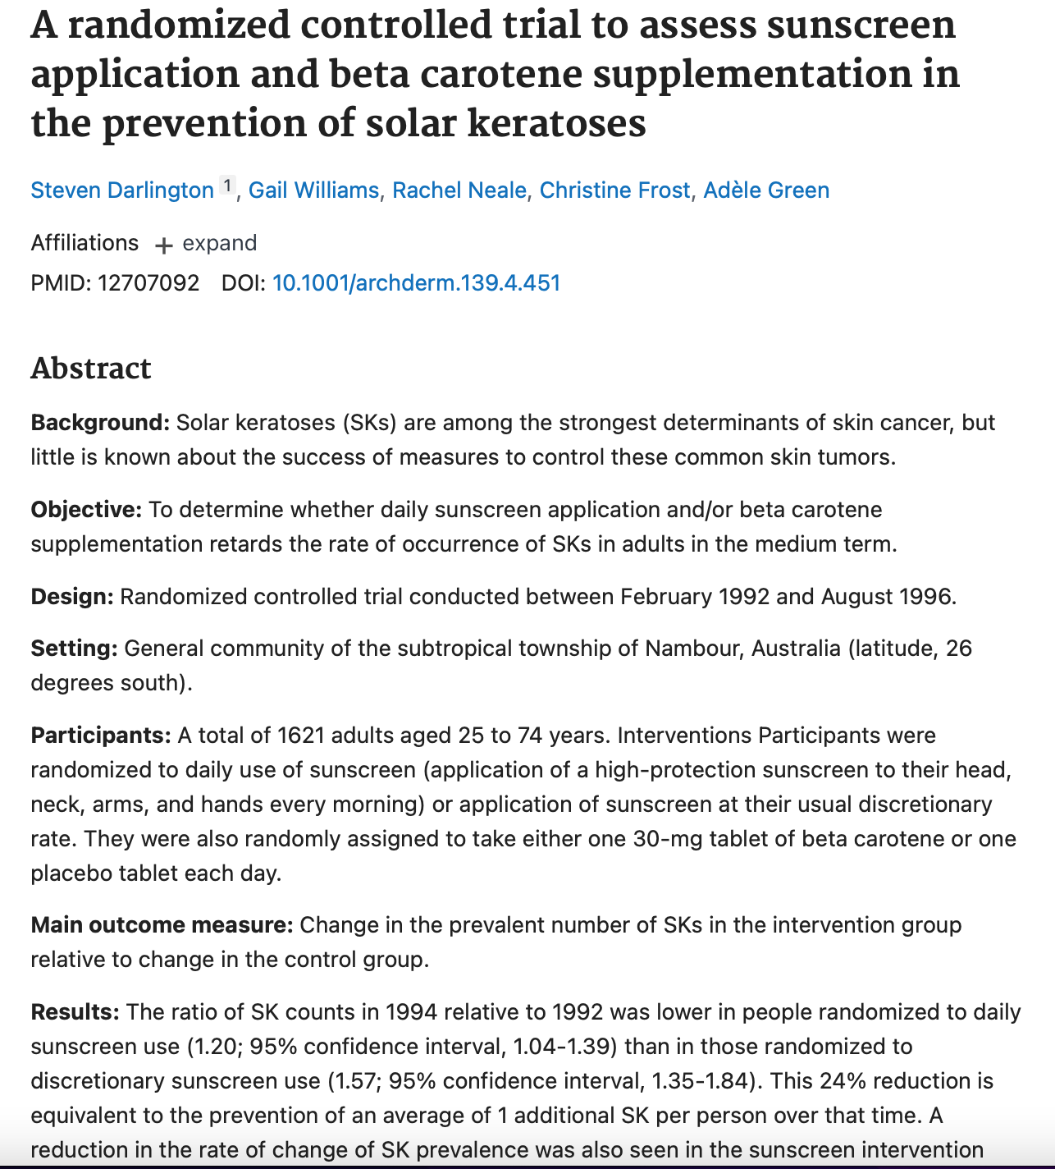
Overview of AK
Nambour Trial
SPF 16 used !!!!!

Slide 10
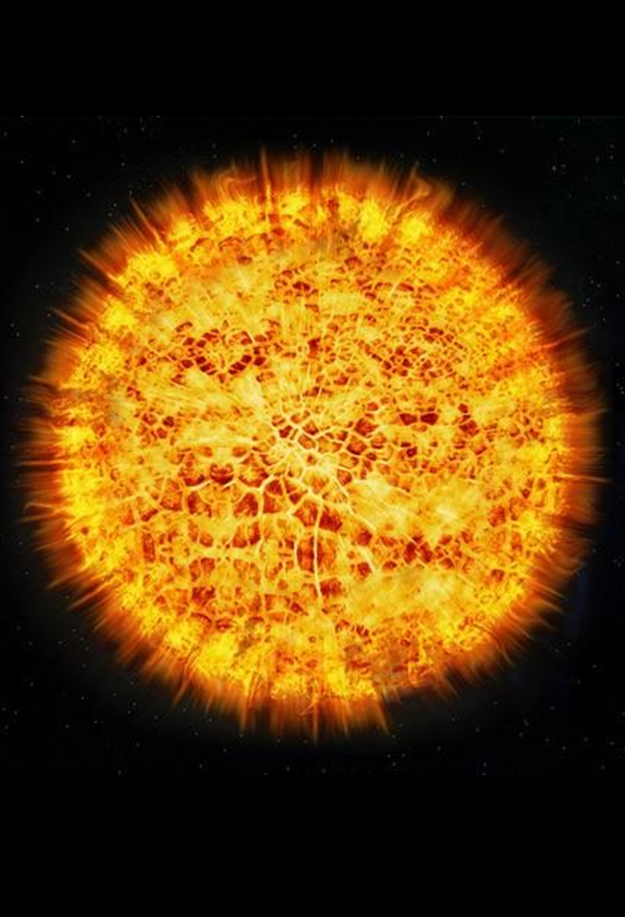
Overview of Actinic Keratosis (AK)
I usually call them solar keratoses.
When talking to patients I use the term “sun spots”.

Slide 11
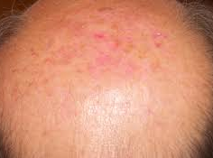
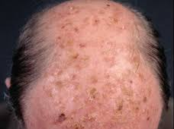
Overview of Actinic Keratosis (AK)
AK lesions appear as small, flat or slightly raised scaly macules or plaques
Their colour varies greatly from a normal skin tone to reddish-brown
They are around 3 mm to 10 mm in diameter and can grow gradually. The skin surrounding the lesion shows other signs of damage caused by UV light, such as dark spots, burst blood vessels and a yellowish colour
Over time, there is a risk that AK lesions will thicken and harden. Occasionally, their colour changes from red to brown. A cone-shaped growth sometimes appears on the lesion, known as a cutaneous horn
AKs are usually located on the face, but lesions can actually appear anywhere on the body that has been chronically exposed to UV light, such as the arms, legs and backs of the hands.

Slide 12

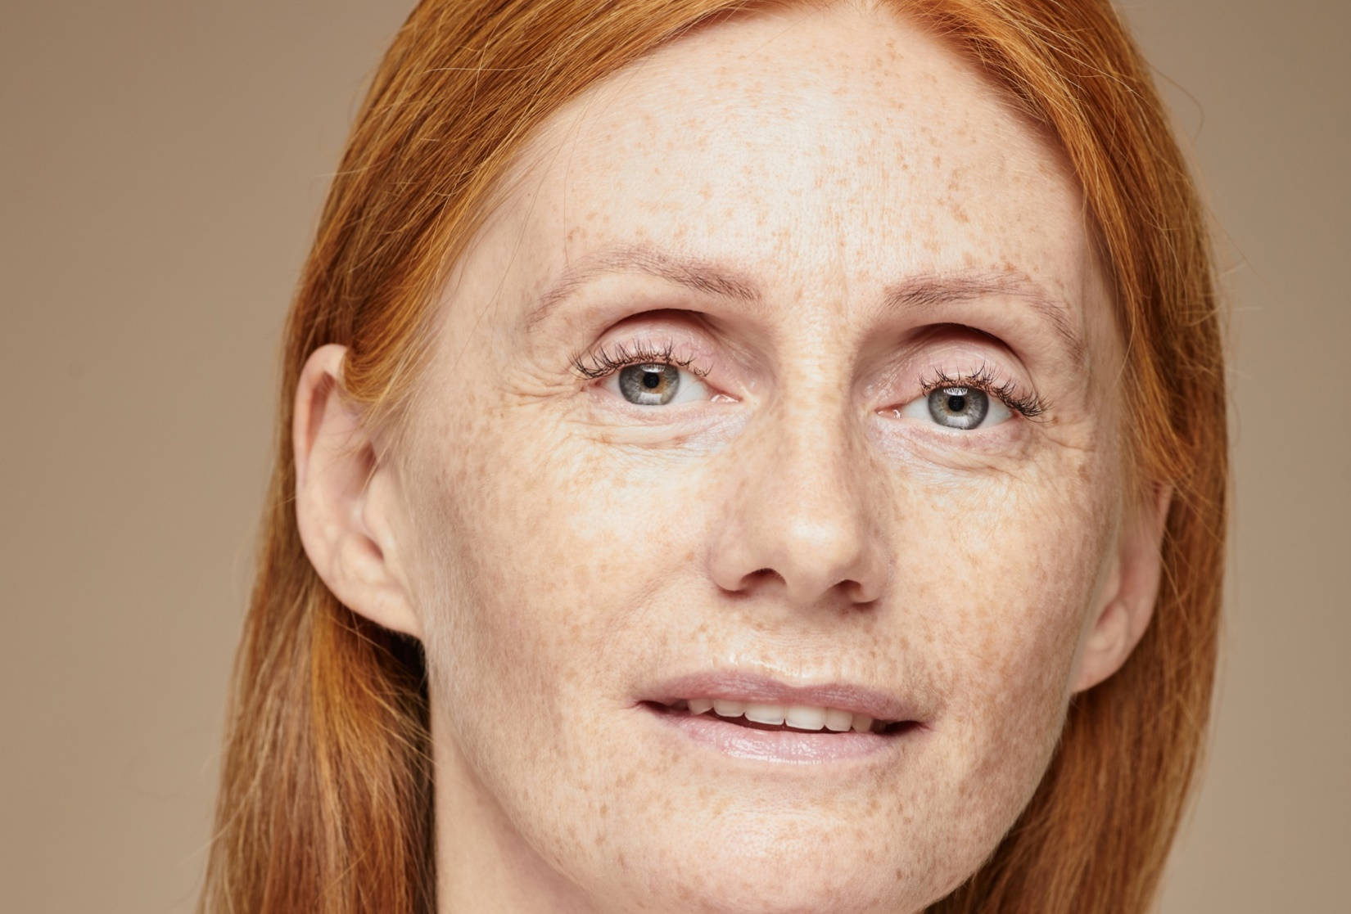
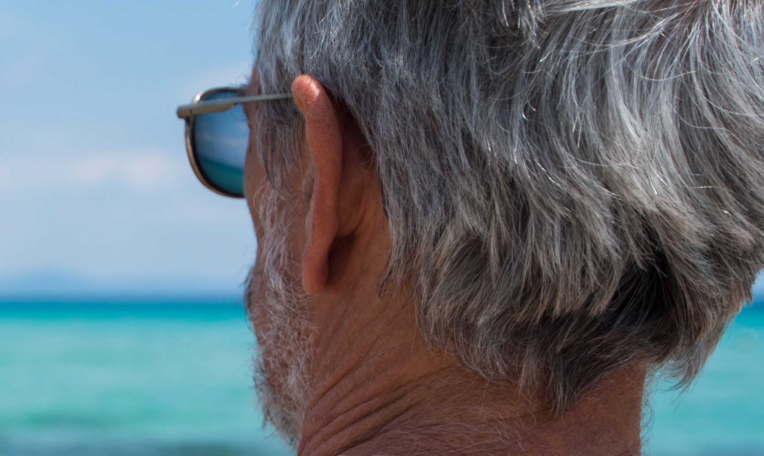
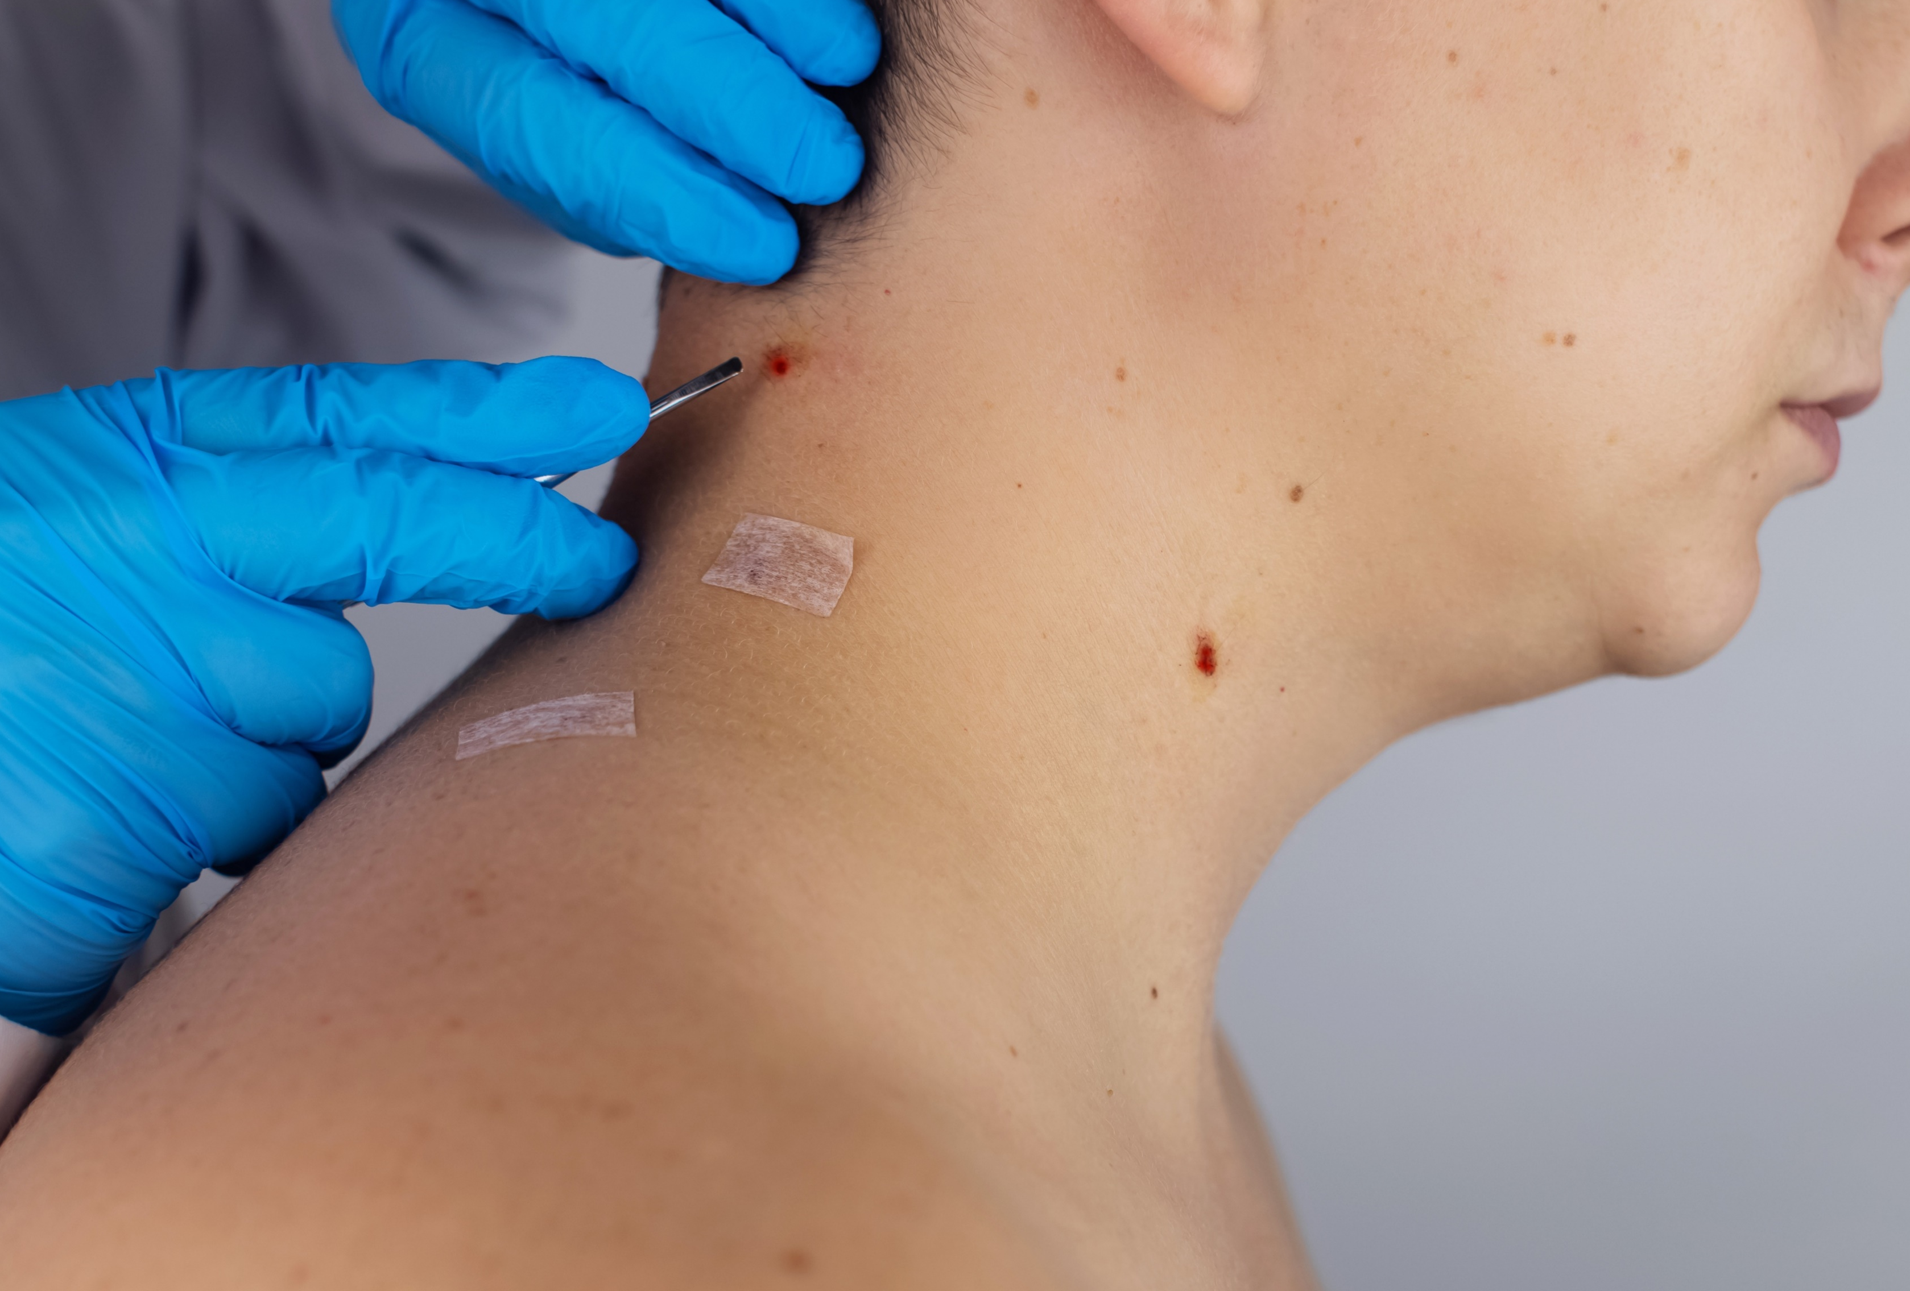
Overview of AK
Risk factors for AK include:
  Fair skin
  Genetic factors associated with increased susceptibility to UV radiation and;
  Accumulated greater lifetime exposure to UV radiation due to outdoor occupations and outdoor activities (e.g. construction, farming)
AKs typically present in areas of greatest sun exposure and hence highest solar damage; more than 80% of all AKs are found on the upper limbs and head and neck region
40-50% in Australians and New Zealanders over the age of 40 years
AKs can evolve into squamous cell carcinoma (SCC) if left untreated with approximately 10% of AKs progressing to SCCs
Patients with AKs high risk for skin cancers vs general population
  Regular skin checks
  Aim to treat most AKs

Slide 13
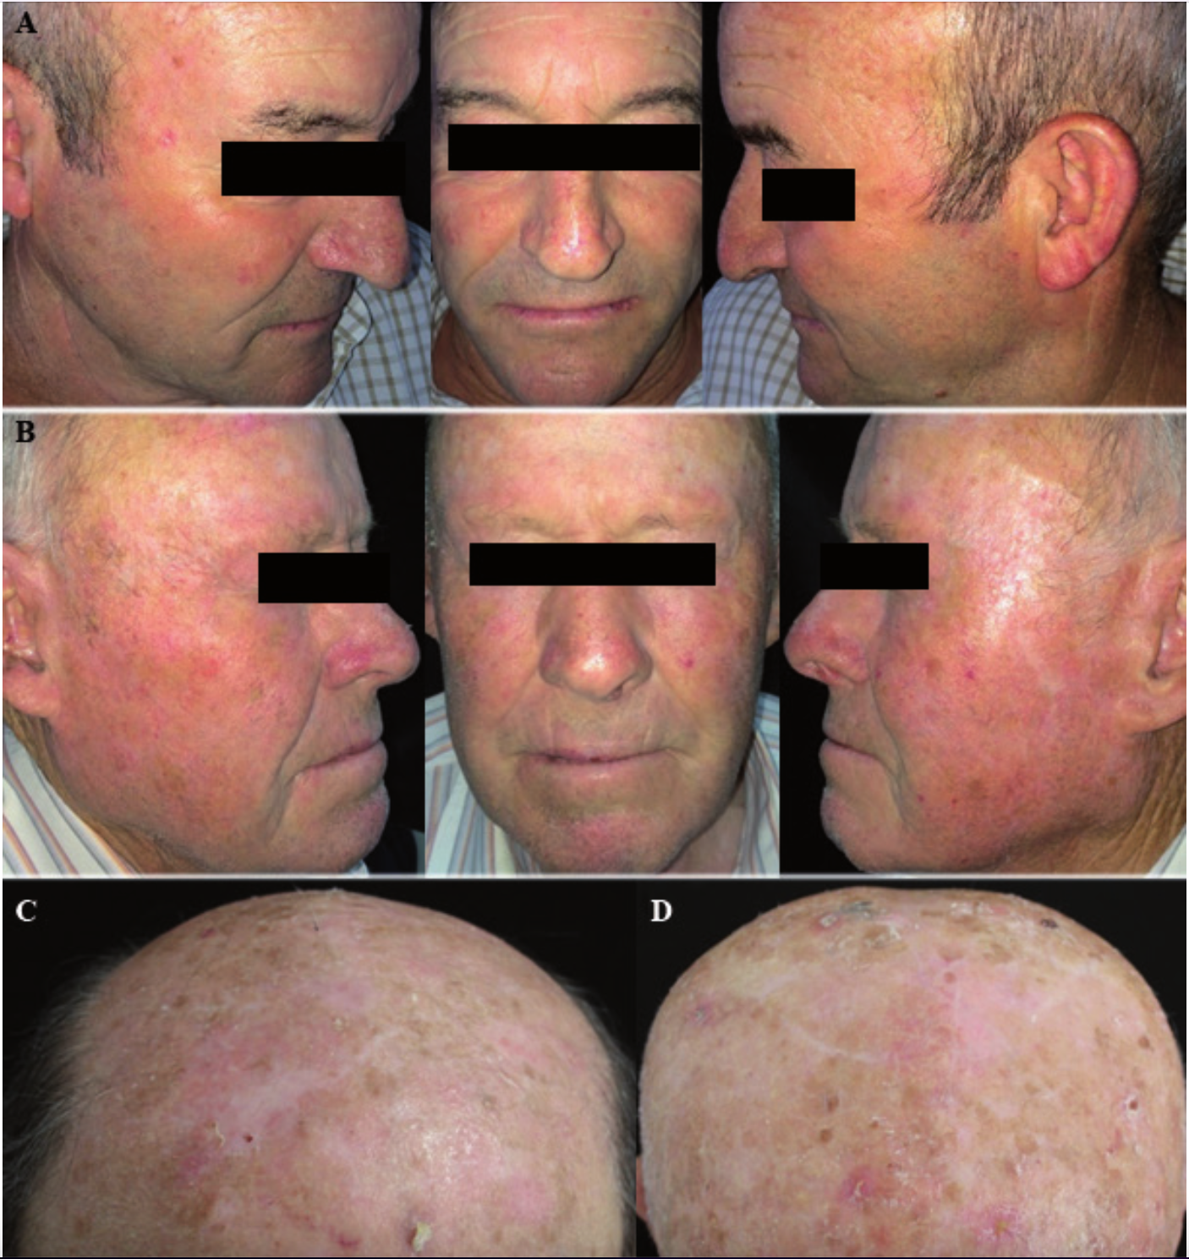
Overview of AK
Olsen clinical grading
I = Image A
II = Image B
III = Images C and D
Note that clinical severity of AK does not correlate with histological severity. Be careful just treating the worst looking AKs.
Grade III -> favour 5-FU based field treatments with pre-treatment (curettage, keratolytics)
Images from
Dréno, Brigitte & Cerio, Rino & Dirschka, Thomas & Figueras, Ignasi & Lear, John & Peris, Ketty & Casas, Andrés & Kaleci, Shaniko & Pellacani, Giovanni. (2017). A Novel Actinic Keratosis Field Assessment Scale for Grading Actinic Keratosis Disease Severity. Acta Dermato Venereologica. 97. 10.2340/00015555-2710.

Slide 14
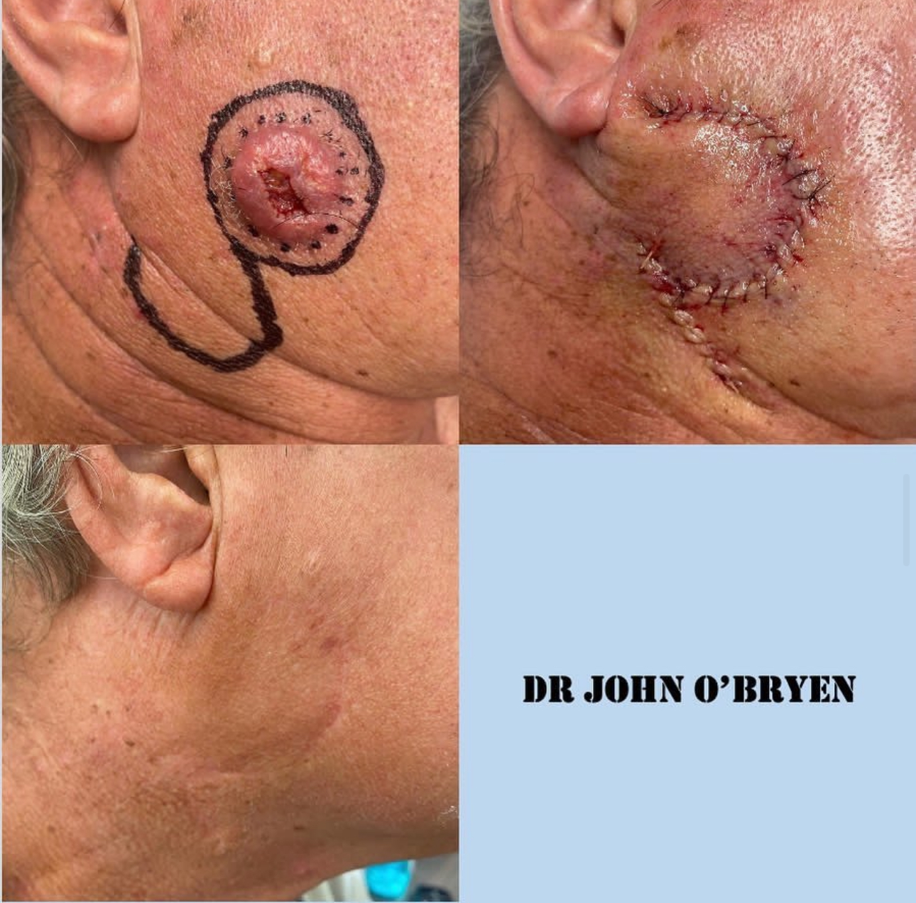
Overview of AK

Slide 15

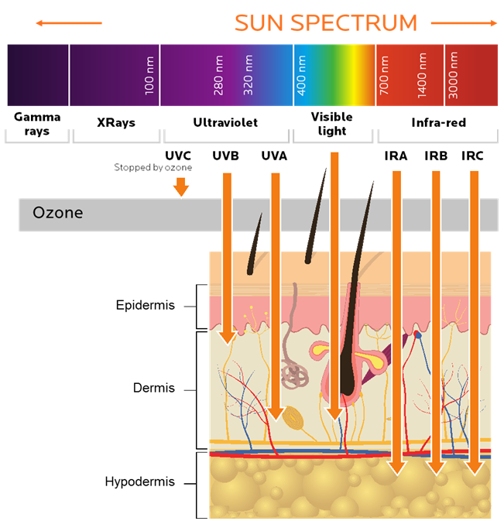
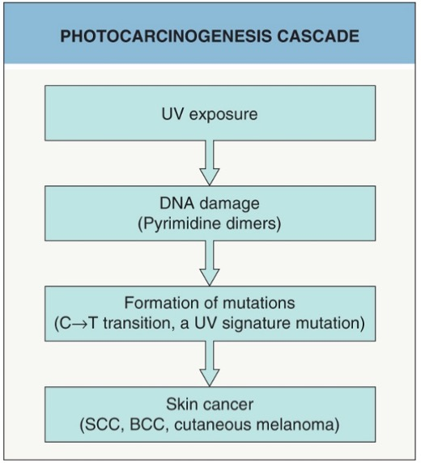
AETIOLOGY OF AK
Bolognia, J. et al. Dermatology, 4th Edition, 2018
Notes:
Multiple pathways and factors involved in the aetiology of AK, however, the most important factor is DNA damage by short wavelength UVB
More than 90% of cases of SCC are associated with numerous DNA mutations in multiple somatic genes. Mutations in the p53 tumours uppressor gene are caused by exposure to ultraviolet radiation (UV), especially UVB (known as signature 7). Other signature mutationsrelate to cigarette smoking, ageing and immune suppression (eg, to drugs such as azathioprine). Mutations in signalling pathways affect the epidermal growth factor receptor, RAS, Fyn, and p16INK4a signalling.
Beta-genus human papillomaviruses (wart virus) are thought to play a role in SCC arising in immune-suppressed populations. β-HPV and HPV subtypes 5, 8, 17, 20, 24, and 38 have also been associated with an increased risk of cutaneous SCC in immunocompetent individuals.

Slide 16
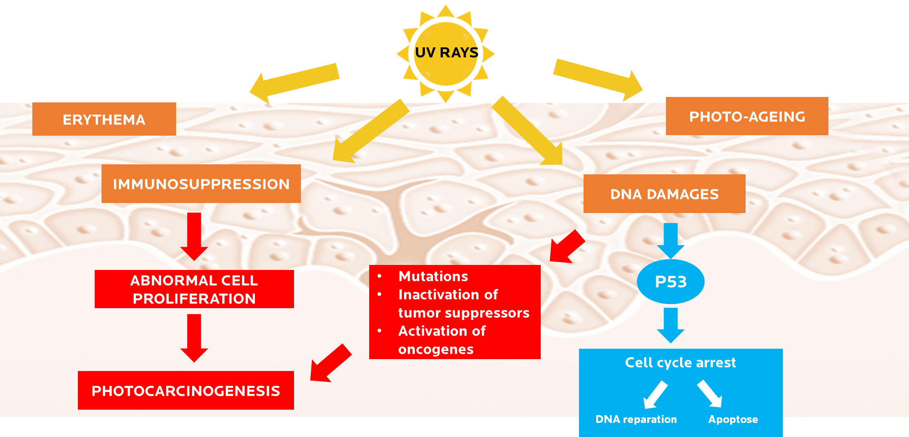
CHRONIC UV EXPOSURE

Slide 17
Treatments Overview

Slide 18
Field-directed Treatments
  General measures for all AK patients
    Education
    Scheduled skin checks
    Photoprotection, daily sunscreen broad spectrum UVA/UVB SPF 50+
    Keratolytics for comfort
    Consider topical niacinamide or oral nicotinamide

Slide 19
Field-directed Treatments
Surgical | Topical medication | PDT | Peels | Other
Cryotherapy | 5-FU in various formulations (Efudix, Tolak, Actikerall, compounded calcipotriol) | MAL or 5-ALA | Trichloroacetic acid | Sunscreen Oral nicotinamide ? Topical niacinamide
Curettage | Imiquimod (Aldara) | LED | Phenol | Topical retinoid (tretinoin), oral retinoid (acitretin)
Excisional biopsy | Diclofenac (Solaraze) | Daylight |  | Wide field radiation
Laser ablation | Tirbanibulin (Onakta) | Laser assisted
 | Ingenol mebutate (Picato)

Slide 20
Overview of AK
Selection of treatment individually tailored and is based on:
  Site of AK, number of AK
  Treatment-related factors such as efficacy, tolerability and burden
  Patient characteristics and preferences should also be considered such as
    Associated symptoms
    Risk of progression to SCC
    Burden of treatment
    Cosmetic appearance of AKs before, during and after treatment
    Cost and convenience

Slide 21
Treatments Overview
John’s tips for cryotherapy
Informed consent, I always begin by asking “Have you had this before? Do you know what to expect?”
Don’t spray and pray. If you don’t know what it is, then biopsy. If you think it is a cancer, treat it as a cancer.
If a clinical solar keratosis has received cryo before and not gone away, then biopsy as could be a cancer.
Avoid cosmetic areas (face, decolatage), over bony prominences and superficial nerves, and below the knee esp. elderly (risk of causing a chronic ulcer).
I avoid long freeze times because risk of ulceration and permanent hypopigmentation
Field problems need field treatments.
Can use to get specimen out of a punch biopsy instrument (but I rarely do punch biopsies for skin cancer and only order instruments that have plungers)!!!
Consider charging extra fee for cryotherapy.

Slide 22
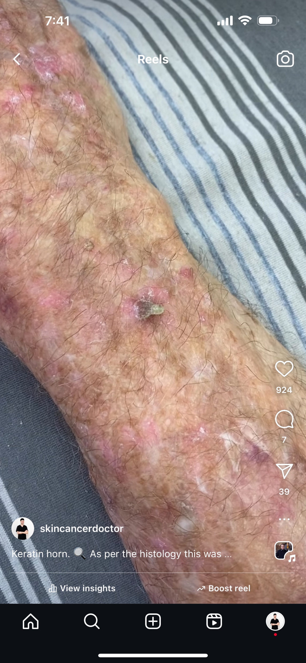
Treatments Overview

Slide 23
Field-directed Treatments

Slide 24
OVERVIEW OF AK
  Many available treatments
  Few well-designed head to head comparisons
  Most studies look at reduction in AK, not cancers prevented
  Currently, treatment choice is driven by physician and patient preference

Slide 25
Field-directed Treatments
Refer to local prescribing advice or product information for the produce of choice for guidance on application, precautions and immediate post treatment care.
  Topic agents such as 5-FU, 5-FU combinations and imiquimod are commonly used, have good efficacy and can be applied focally or in broad areas.
  Local skin reactions such as erythema, itching, burning and crusting
  Though the side effects are temporary they can result in non-compliance and clinicians should work with the patient to customize the treatment to achieve the desired outcomes
  PDT requires the application of pre-photosensitiser, to the area of the skin to be treated, one to four hours before exposure to a light source with LED, and within 30 mins for daylight
    This mode of treatment has also reported good efficacy and has the added benefit of administration in the office setting which may offer improved compliance compared to topical agents administered by patients at home.
    Phototoxic reactions can result in erythema, stinging, itching, oedema and exudation which can take around 10 days to heal

Slide 26
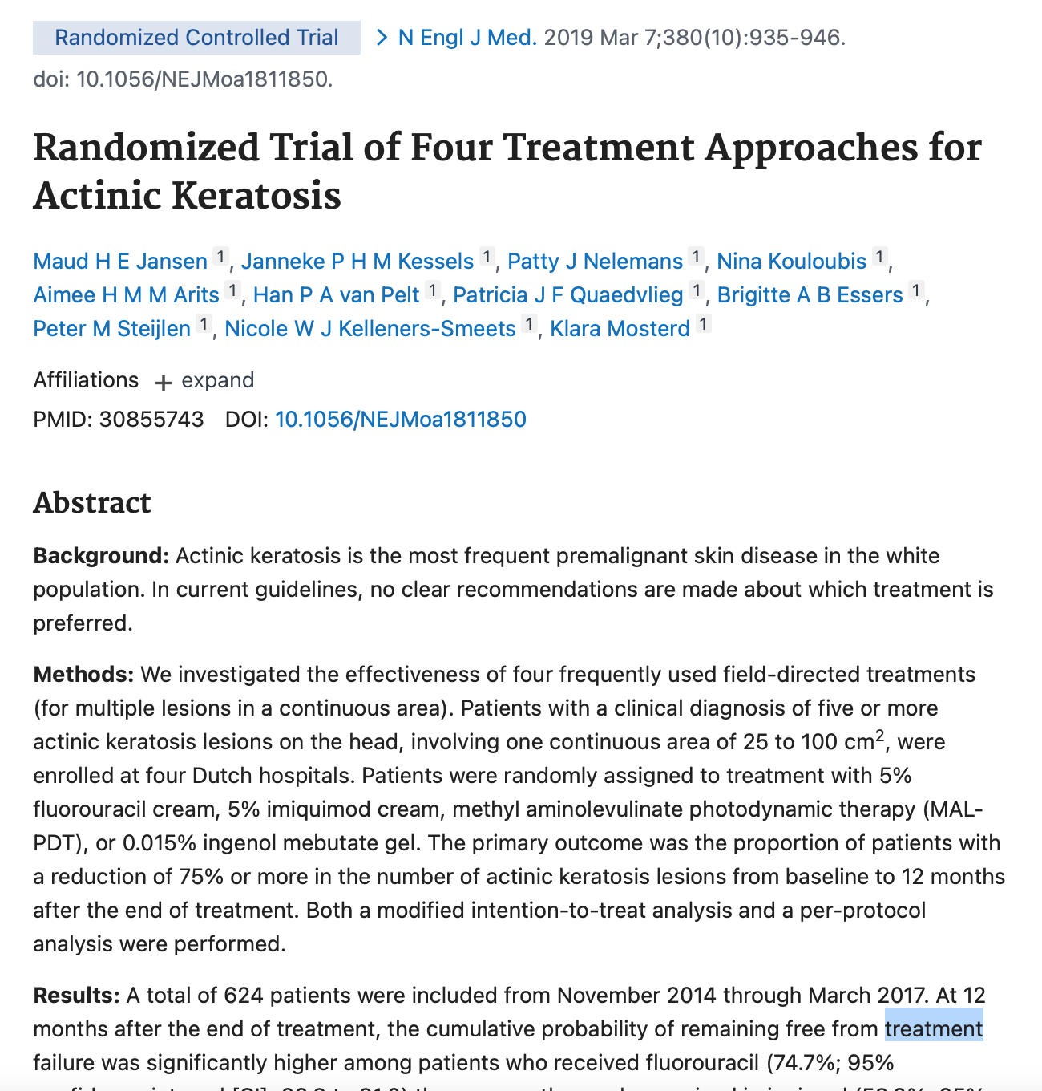
Field-directed Treatments

Slide 27
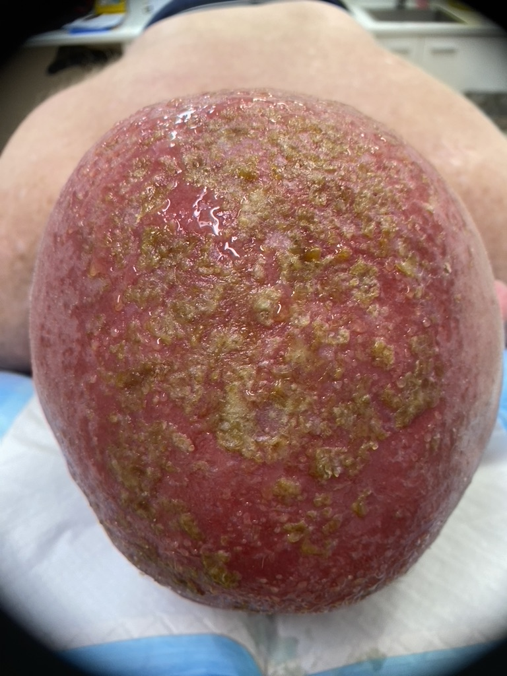
Field-directed Treatments
Scalp of 57 yo man 9 days into
5-FU 5% cream applied twice daily

Slide 28
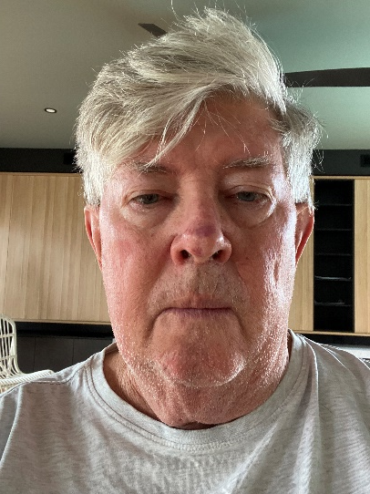
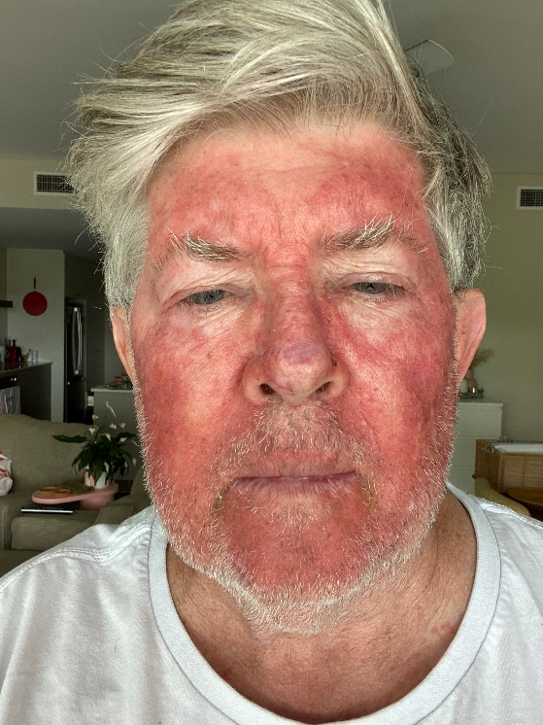
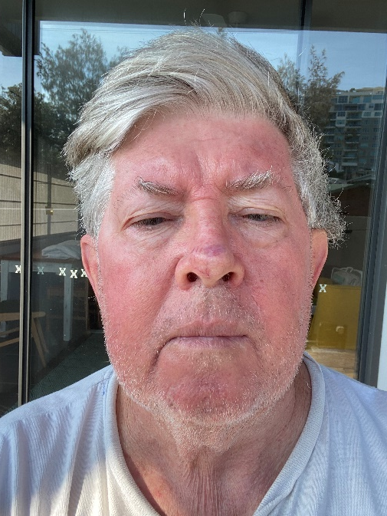
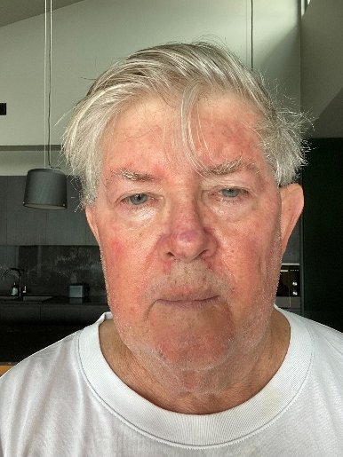
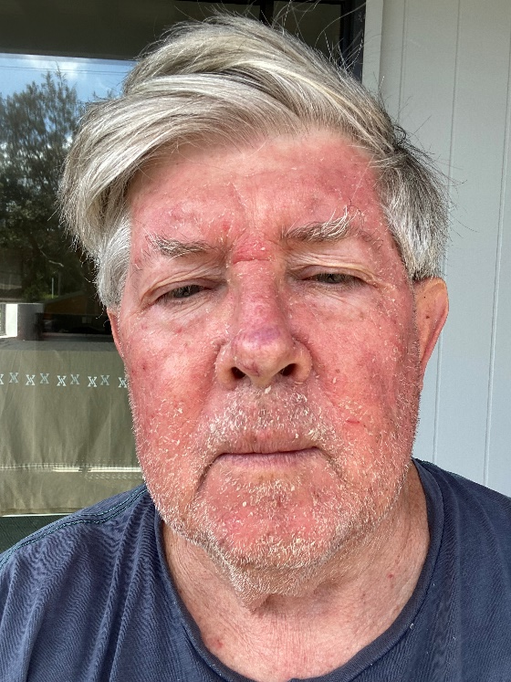
Field-directed Treatments
Day 1
Day 7
Day 20
Compounded 5-FU + calcipotriol field treatment face
Twice daily for 4 days
Day 3
Day 14

Slide 29
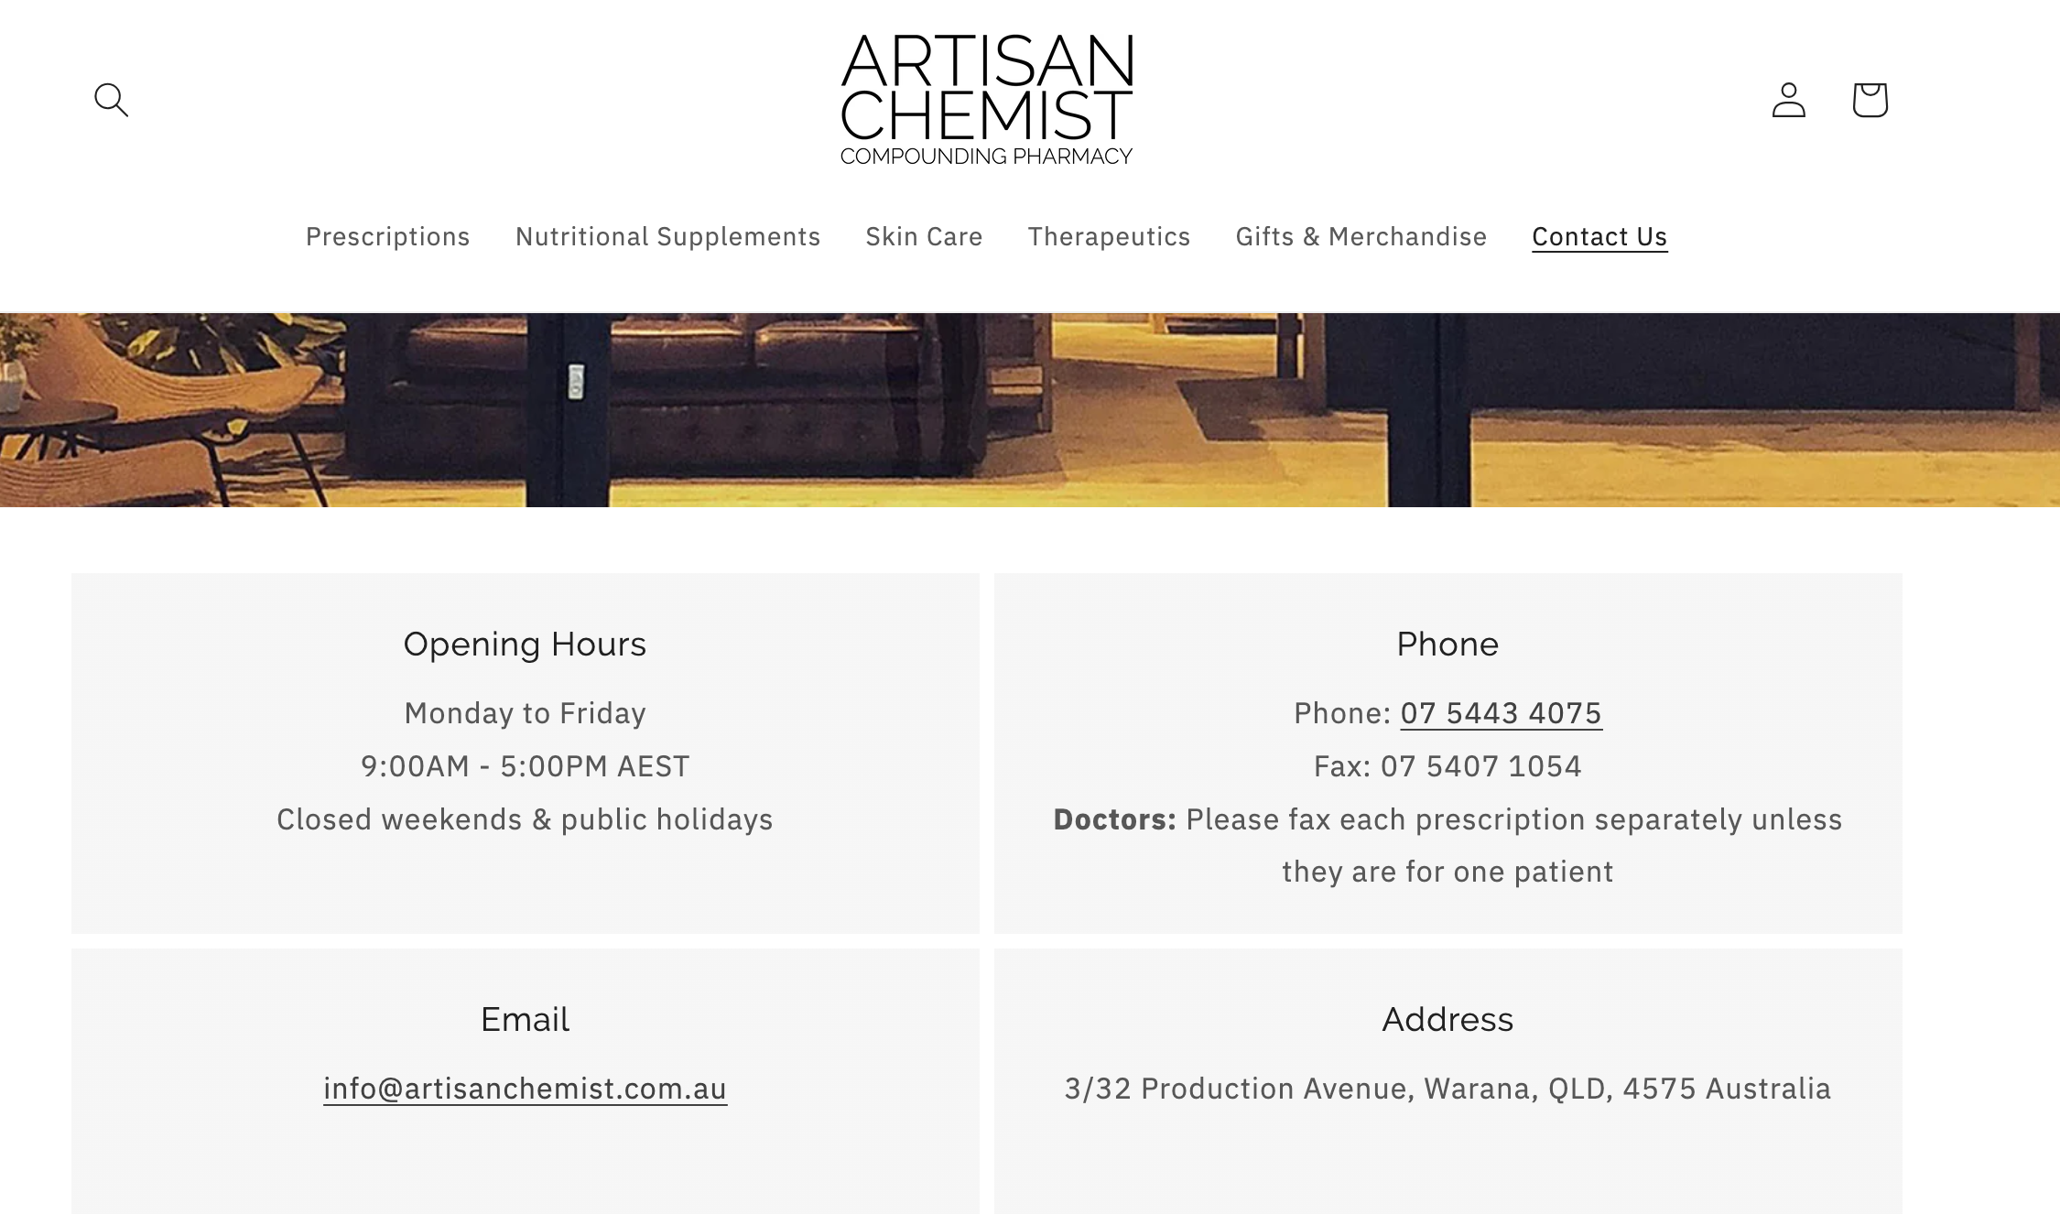
I use Artisan Chemist for prescribing 5FU + calcipotriol for my patients. Standard dosing is BD for 4 days face, 2 days lips, 6 days elsewhere. Sometimes need longer treatment.
I also use the chemist for ordering 5-ALA 20% cream at $150 for 20g (can treat 10-20 patients).

Slide 30
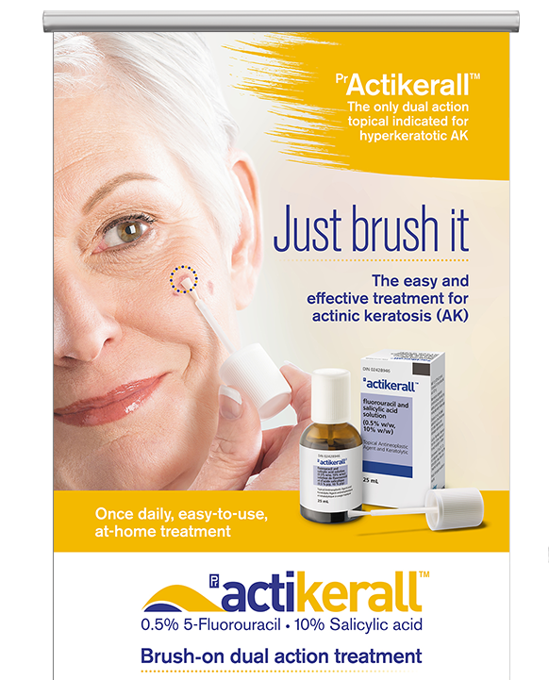
Field-directed Treatments
Newer topicals on the market
Actikerall (fluorouracil 0.5% and salicylic acid 10%)
Solution in a bottle with applicator brush
Applied daily until lesions cleared to maximum 12 weeks
Can drop to 3x a week application if not tolerating
Dries leaving a film, sunscreen can be used over the top
(if skin not eroded)
Can stain clothing
Shave area before using as makes hairs stick together
Not recommend to treat more than 25cm²

Slide 31
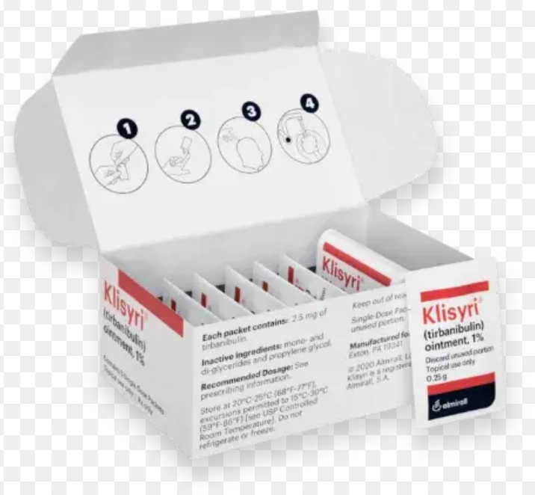
Field-directed Treatments
Newer topicals on the market
Onakta (tirbanibulin 1%)
Ointment in single dose sachets
Applied daily for 5 days to field up to 25cm²
on face or scalp
Microtubule inhibitor
Similar skin reaction to 5FU
Approved TGA Feb 2024 for Olsen grade I face or scalp
My local pharmacy cannot order it in yet

Slide 32
Field-directed Treatments
John’s thoughts on field treatments for actinic keratoses
Get to know your patients including occupation, activities, travel plans, motivation.
My patients are more likely to undertake a field treatment that is simple and quick.
Any field treatment is better than none. Many are put off by family or friends who have done long course 5-FU
Invite first timers in for first application of topicals. Review them through treatment.
My preferred field treatment for face and scalp is daylight PDT. I supply the 5-ALA. Single application. I control where applied. Minimal pain. Weather dependent. Downtime typically short. Income for me.
My second preferred field treatment is 5-FU + calcipotriol “quick Efudix”. Cheaper for patient $78 for 10g enough to treat whole face. Longer downtime than PDT. Not weather dependent. If unsatisfactory response to above I then recommend long course 5-FU (Efudix, Tolak, Actikerall)
For refractory, severe field disease on the limbs I offer 5-FU chemowraps
For patients intolerant of 5-FU I explore the other options -> PDT, diclofenac, imiquimod, tirbanibulin

Slide 33
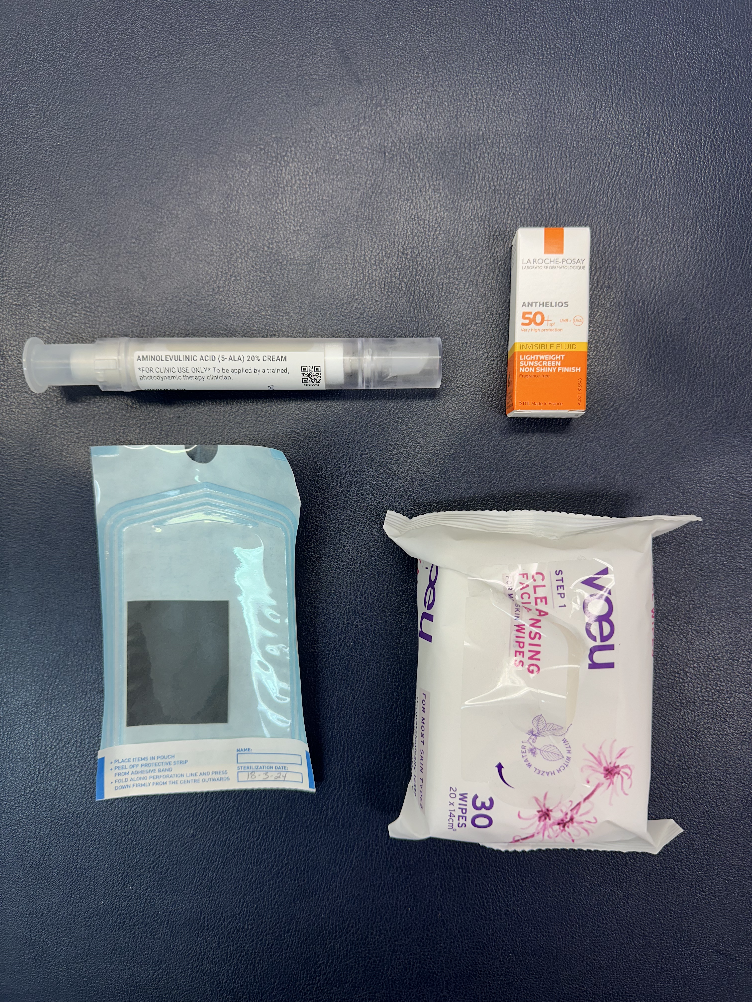
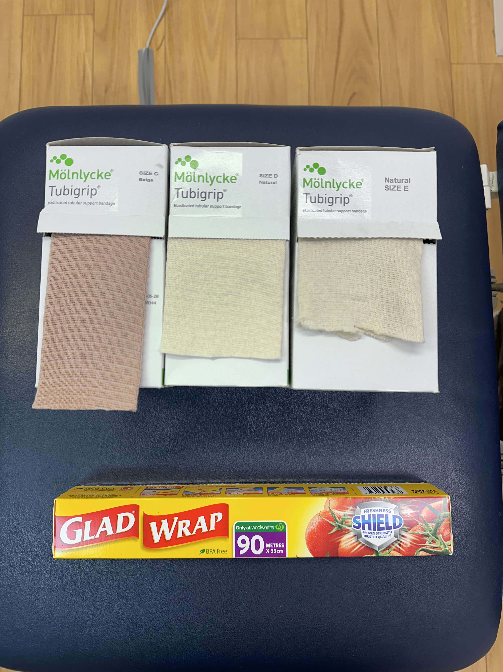
Equipment for daylight PDT
Equipment for chemowraps, pt provides 5-FU 5% cream

Slide 34
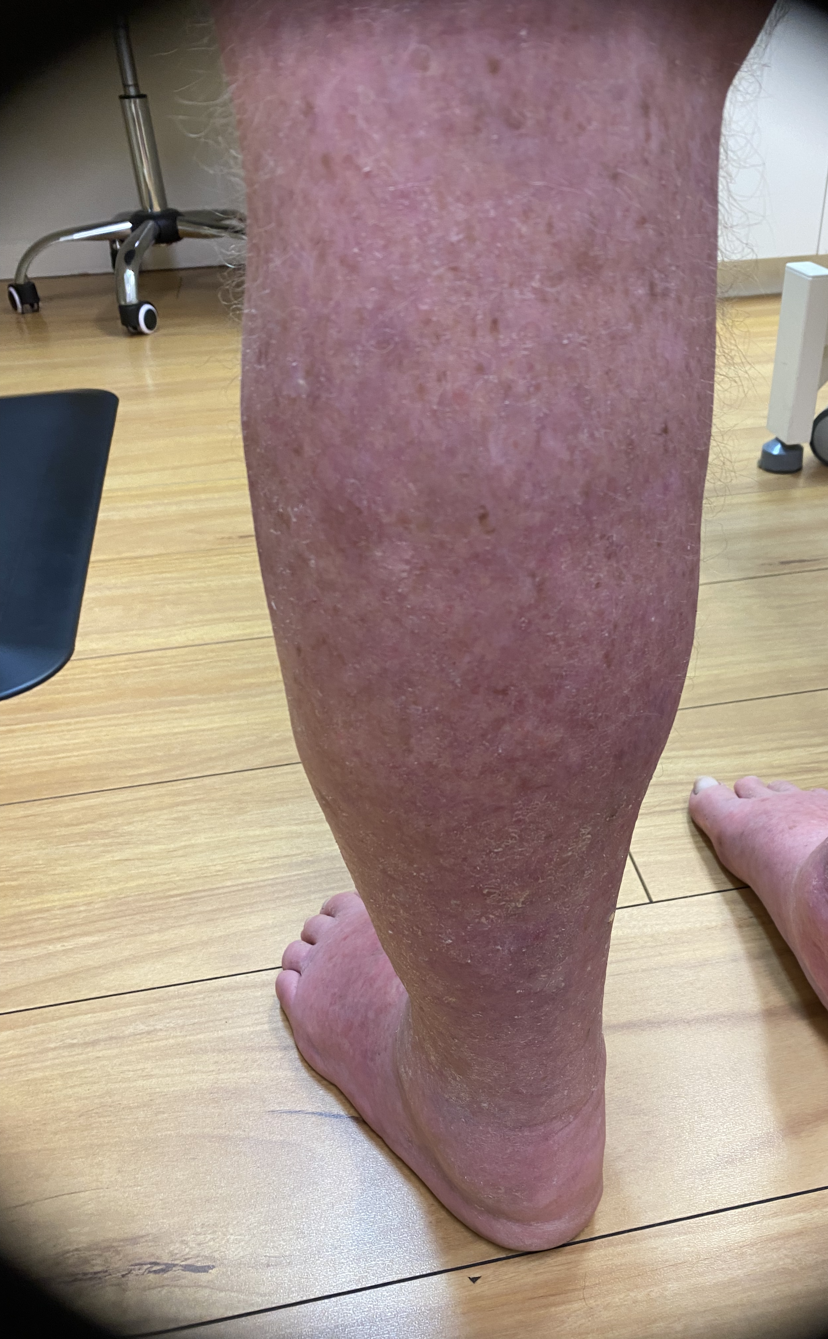
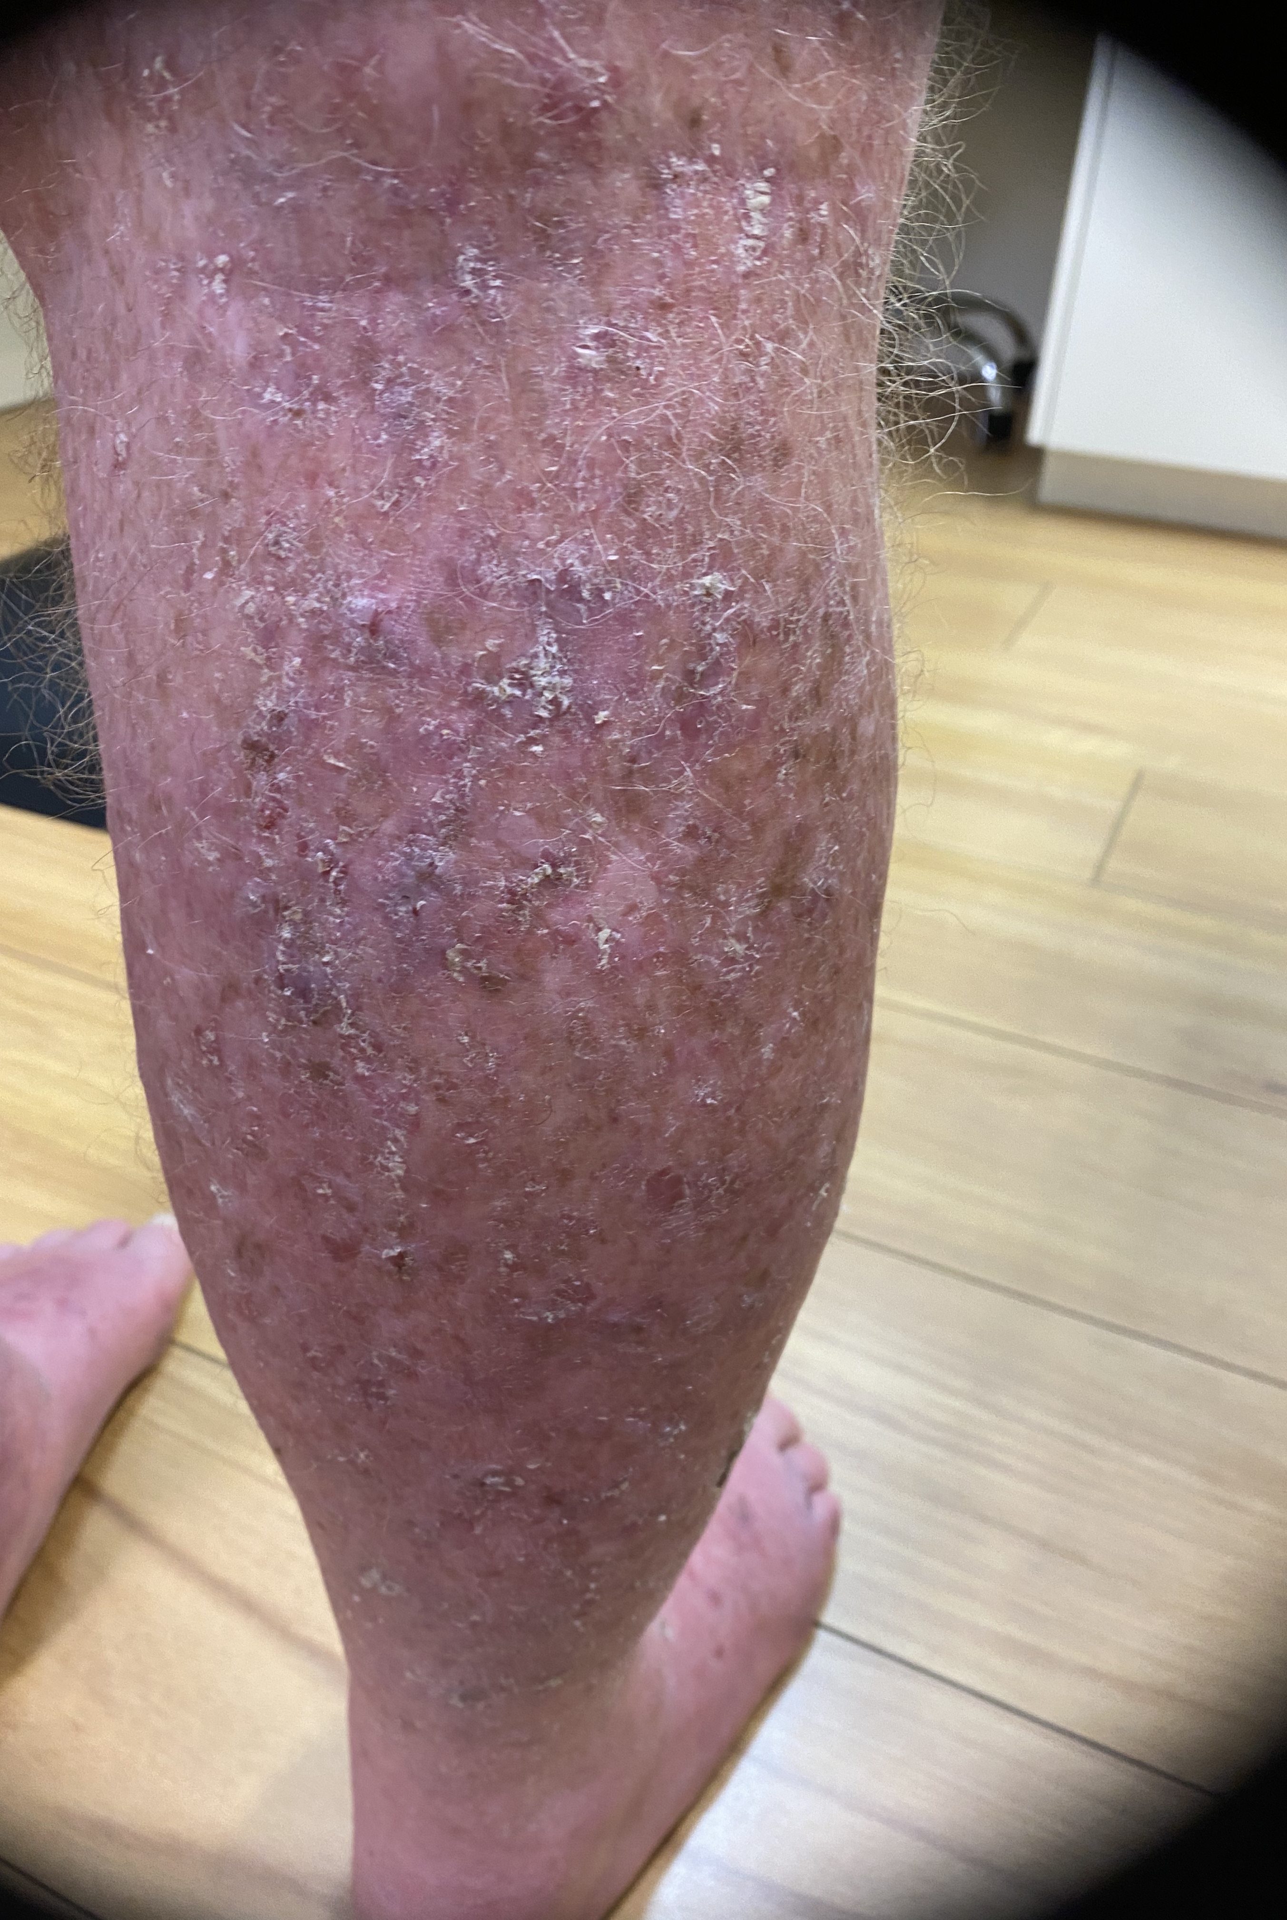
5-FU chemowraps
Left leg treated
Right leg untreated

Slide 35
Summary
AWAITING PUBLICATION
 | Field-directed treatments
Pre-care Remove makeup. Wash the area with a gentle soap-free, fragrance free cleanser. Dry thoroughly. Consider curettage or the application of keratolytic agent for hyperkeratotic lesions. | After-care Use a gentle cleanser with a pH ≈ 5 that is acceptable for all skin types. Consider a barrier repair cream such as soothing balm with panthenol. Consider an emollient that is fragrance free with a hydrating formulation. Sun protection Use sun protection everyday and minimise exposure at peak UV rating. Sun protection should be used when outdoors or near a window. Use clothing with a high UPF that covers the body from wrist to ankle. Wear sunglasses and a wide brimmed hat. Apply sunscreen with SPF 50+ UVA/UVB protection on all exposed areas. Apply daily on all exposed sites and use an appropriate amount of sunscreen. Use clothing on any sites that are inflamed or broken. Do not use sunscreen on these sites. Reapply sunscreen twice daily. Apply every two hours when skin is exposed to water, or if in the sun for prolonged periods of time, or if sweating excessively. | Prevention of Relapse Consider the use of oral nicotinamide in the morning and evening if patient is at high risk for developing skin cancer or frequent relapse of skin cancer. Know when to refer to a dermatologist for oral acitretin. Consider the use of topical retinoids for chronic actinic damage reversal. Sun protection Use sun protection everyday and minimise exposure at peak UV rating. Sun protection should be used when outdoors or near a window. Use clothing with a high UPF that covers the body from wrist to ankle. Wear sunglasses and a wide brimmed hat. Apply sunscreen with SPF 50+ UVA/UVB protection on all exposed areas. Apply daily on all exposed sites and use an appropriate amount of sunscreen. Reapply sunscreen twice daily. Apply every two hours when skin is exposed to water, or if in the sun for prolonged periods of time, or if sweating excessively.
Lesion-directed treatments | Lesion-directed treatments
Pre-care Consider curettage for hyperkeratotic lesions | After-care Follow the same guidelines as for field-directed treatments including sun protection. Cryotherapy can result in skin blistering and so sunscreen and other topical products should be avoided in those areas until the skin is repaired. | Prevention of Relapse Follow the same guidance as for field-directed treatments including sun protection. Field treatment should be considered if relapse occurs.
Notes:
Prevention of relapse
Advise the patient to apply sun protection as described above. Consider the use of oral nicotinamide in the morning and event for patients at high risk for developing skin cancer or frequent relapse of skin cancer. Consider the use of topic retinoids for chronic actinic damage reversal.

Slide 36
Field-directed Treatments
After-care
  See the patient 1 week after completion of treatment, particularly if this is the first field-directed treatment
  Ask patient to take photographs of the treated skin
  Assess the lesions for response after 1 month and follow-up with the patient if the lesions are nonresponsive and consider biopsy
  Many of the treatments for AK have associated side effects which may affect skin barrier function. Patients should be instructed on how to care for the skin during the healing process, once skin texture and tone has returned to normal after treatment
  Instruct the patient to use a gentle cleanser with a pH of approximately 5 that is acceptable for all skin types
  Consider using a barrier repair cream such as a soothing balm with panthenol
  An emollient that is fragrance free, with a hydrating formulation that is acceptable to patients can be used

Slide 37
Field-directed Treatments
  Sun protection
    Provide advice to the patient on reducing or preventing further sun damage by ensuring appropriate outdoor clothing is worn and the use of sunscreens. Let the patient know that regular use of sunscreen not only prevents the development of AK, but also helps with the remission of the existing AK
    Advise the patient to use sun protection everyday regardless of the weather and to minimise exposure to the sun at the peak UV rating. Sun protection should be used whenever the patient is outdoors or near a window.
    Sun protection is best provided through the use of clothing with a high ultraviolet protection factor (UPF) that covers the body from wrist to ankle. Advise patient to also wear sunglasses and a wide brimmed hat.

Slide 38
Field-directed Treatments
  Sunscreen
    A sunscreen with SPF 50+ UVA/UVB protection suitable for the patient’s skin type, should be applied on all exposed areas.
    The sunscreen should be applied daily on all exposed sites apart from any sites that are still inflamed or broken due to treatment.
    Advise the patient to use appropriate clothing on inflamed skin until the skin barrier is restored to protect the area from the sun.
    Ensure that an adequate amount of sunscreen is applied. The recommended application is 5mL for each arm, leg, body front, body back and face (including neck and ears). This equates to a total of 30 mL for a full body application.
    Sunscreen should be reapplied twice daily. This is particular important in the summer months. Sunscreen should be reapplied every 2 hours when skin is exposed to water, or the person has been sweating excessively, or they are in the sun for prolonged periods of time.

Slide 39
B3
Nicotinamide/niacinamide
  Nicotinamide also called Niacinamide is an amide form of Vitamin B3 and is widely available in plants and animal tissues
  Nicotinamide is a precursor for nicotinamide adenine dinucleotide (NAD+) synthesis, essential for cellular energy
  The role of NAD+ in carcinogenesis is highly linked to the nuclear enzyme, poly- (adenosine-diphosphate [ADP]-ribose) polymerase 1 (PARP-1), as NAD+ is the substrate of PARP-1.
  UV irradiation and the process of DNA reparation by PARP-1 depletes NAD+ levels and cellular energy in the skin
  In vitro studies have demonstrated that addition of nicotinamide can replenishes intracellular NAD+ and therefore increases cell survival
  Nicotinamide has also demonstrated efficacy to upregulate p53 gene expression

Slide 40
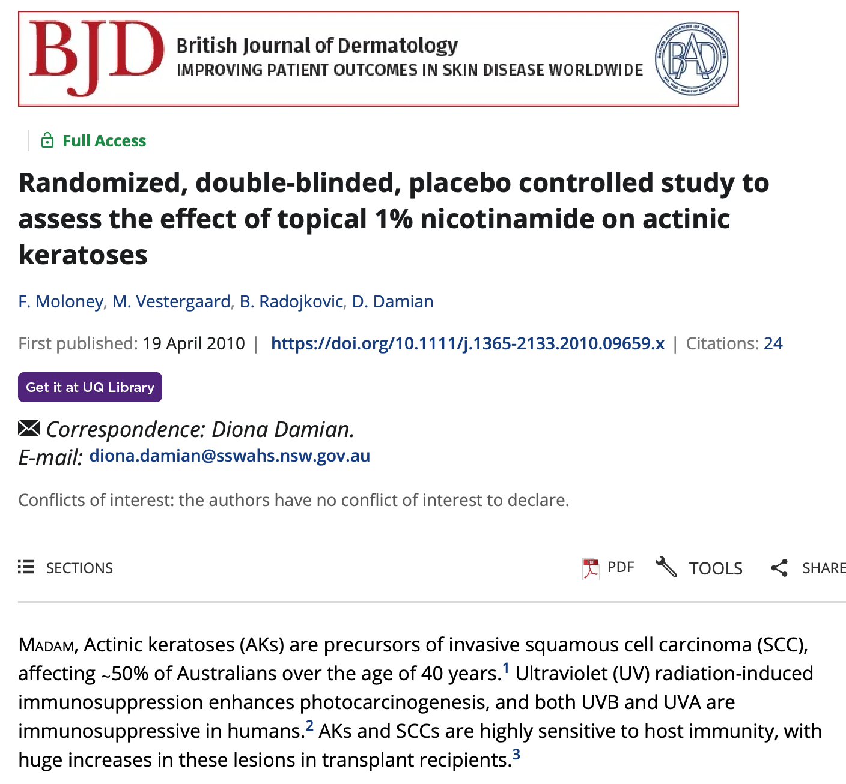
B3

Slide 41
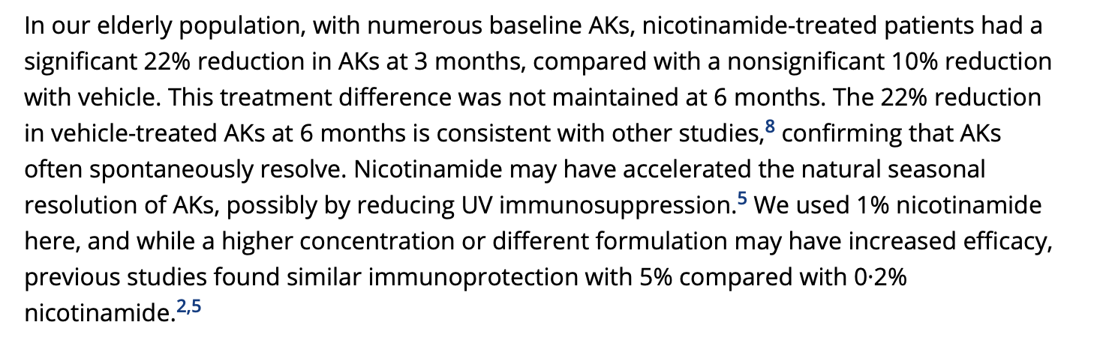
B3

Slide 42
B3
Points of interest for me
Getting an LED light for PDT
Laser treatments for AK
Combination therapies such as 1 week 5-FU prior to PDT
Familiarising with Onakta and Actikerall
More evidence for 5FU + calcipotriol and TGA approval
Larger trials on topical niacinamide with and without sunscreen for preventing AKs and cancers

Slide 43
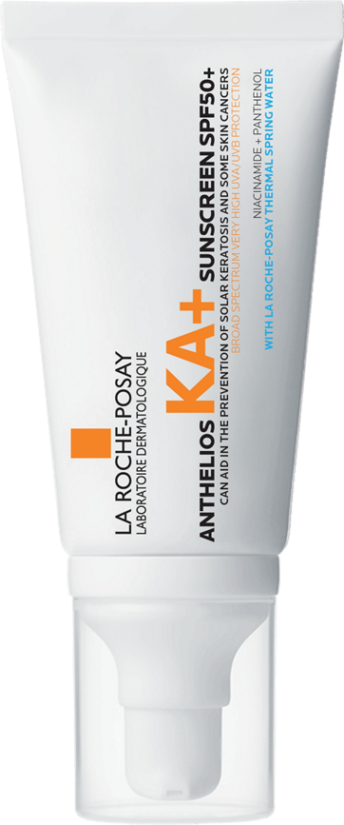
ANTHELIOS KA+
BROAD SPECTRUM SPF 50+ SUNSCREEN
DERMATOLOGICALLY TESTED FOR SENSITIVE SKIN
COMFORTS
& SUPPORTS
1
VERY HIGH PROTECTION
2
3
INVISIBLE FINISH
VERY HIGH UVA/UVB PROTECTION
CAN AID IN THE PREVENTION OF SOLAR KERATOSIS AND MAY REDUCE THE RISK OF SOME SKIN CANCERS
WITHOUT LEAVING WHITE MARKS. SUITABLE FOR ALL PHOTOTYPES
AIDS IN SUPPORTING & REPAIRING THE SKIN MOISTURE BARRIER
ALWAYS READ THE LABEL AND FOLLOW THE DIRECTIONS FOR USE. Apply 20 minutes before sun exposure. Sunscreen is only one part of sun protection so wear protective clothing and seek shade. Avoid prolonged sun exposure. Reapply every 2 hours and after swimming, towelling and perspiring in accordance with directions.
References
In-vitro study, histological observation on artificial skin
In-vitro study, measurement of P53 protein level in artificial skin
In vitro-study, measurement of telomere length and % of short telomers on artificial skin by Q-FISH
Seite, S., & Moyal, D. (2017). Prevention of Actinic Keratosis by a Very High UVB/UVA Daily Photoprotectant. SKIN The Journal of Cutaneous Medicine, 1(3.1), s118. https://doi.org/10.25251/skin.1.supp.117
Camillo, L. et al. attenuates UV-induced stress damage in human primary keratinocytes from cancerization fields. J Invest Dermatol. (2022) 142:1466–77.e1. 10.1016/j.jid.2021.10.012
Saini, N. et al. UV-exposure, endogenous DNA damage, and DNA replication errors shape the spectra of genome changes in human skin. PLoS Genet. 2021 Jan 14;17(1):e1009302. doi: 10.1371/journal.pgen.1009302. PMID: 33444353; PMCID: PMC7808690.

Slide 44

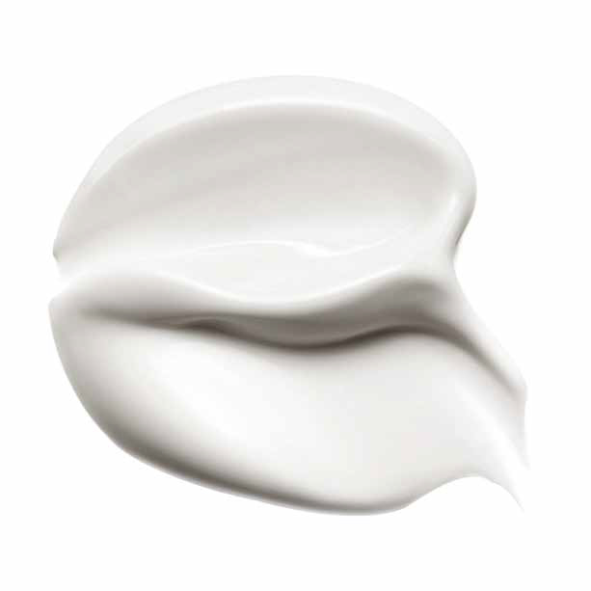
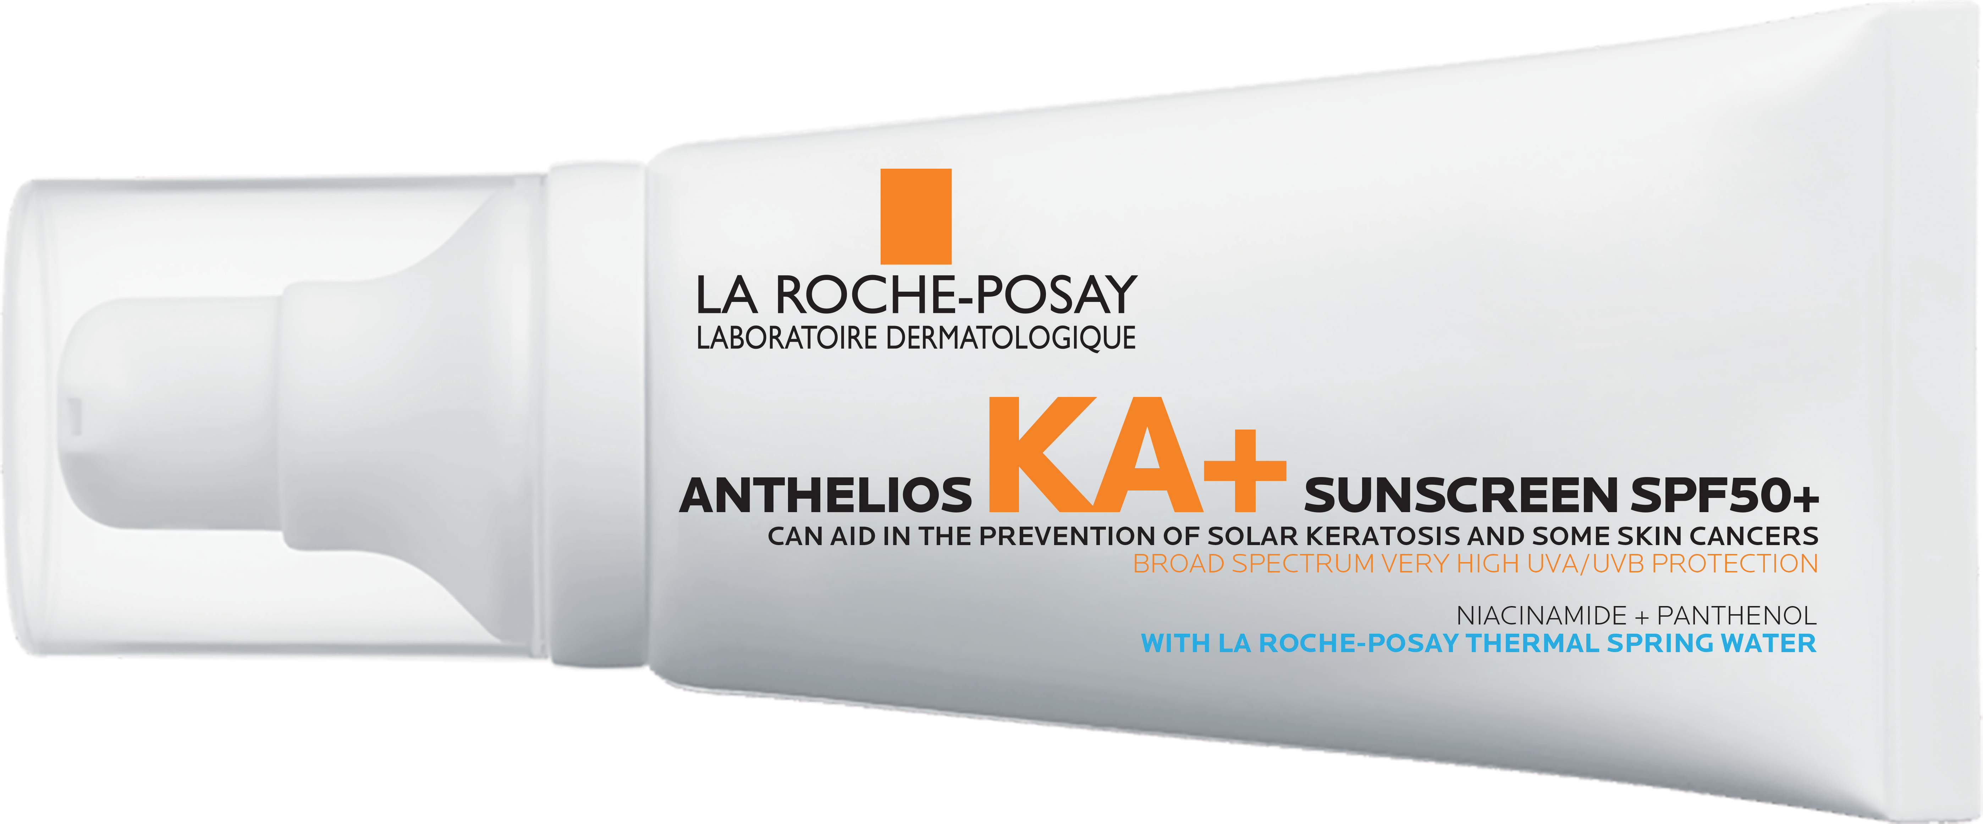

PROTECTS
UNIQUE XL PROTECT FILTERING SYSTEM WITH PHYSICAL AND CHEMICAL FILTERS
VERY HIGH UVA/UVB PROTECTION
MELT-IN TEXTURE
ENHANCING COMPLIANCE
SUPPORTS SKIN MOISTURE BARRIER REPAIR
2% NIACINAMIDE
Non greasy
No white marks
Fragrance Free
ALWAYS READ THE LABEL AND FOLLOW THE DIRECTIONS FOR USE. Apply 20 minutes before sun exposure. Sunscreen is only one part of sun protection so wear protective clothing and seek shade. Avoid prolonged sun exposure. Reapply every 2 hours and after swimming, towelling and perspiring in accordance with directions.
References
In-vitro study, histological observation on artificial skin
In-vitro study, measurement of P53 protein level in artificial skin
In vitro-study, measurement of telomere length and % of short telomers on artificial skin by Q-FISH
Seite, S., & Moyal, D. (2017). Prevention of Actinic Keratosis by a Very High UVB/UVA Daily Photoprotectant. SKIN The Journal of Cutaneous Medicine, 1(3.1), s118. https://doi.org/10.25251/skin.1.supp.117
Camillo, L. et al. attenuates UV-induced stress damage in human primary keratinocytes from cancerization fields. J Invest Dermatol. (2022) 142:1466–77.e1. 10.1016/j.jid.2021.10.012
Saini, N. et al. UV-exposure, endogenous DNA damage, and DNA replication errors shape the spectra of genome changes in human skin. PLoS Genet. 2021 Jan 14;17(1):e1009302. doi: 10.1371/journal.pgen.1009302. PMID: 33444353; PMCID: PMC7808690.
COMFORTS
2% PANTHENOL
AIDS SKIN MOISTURE BARRIER REPAIR
Notes:
References
References
In-vitro study, histological observation on artificial skin
In-vitro study, measurement of P53 protein level in artificial skin
In vitro-study, measurement of telomere length and % of short telomers on artificial skin by Q-FISH
Seite, S., & Moyal, D. (2017). Prevention of Actinic Keratosis by a Very High UVB/UVA Daily Photoprotectant. SKIN The Journal of Cutaneous Medicine, 1(3.1), s118. https://doi.org/10.25251/skin.1.supp.117
Camillo, L. et al. attenuates UV-induced stress damage in human primary keratinocytes from cancerization fields. J Invest Dermatol. (2022) 142:1466–77.e1. 10.1016/j.jid.2021.10.012
Saini, N. et al. UV-exposure, endogenous DNA damage, and DNA replication errors shape the spectra of genome changes in human skin. PLoS Genet. 2021 Jan 14;17(1):e1009302. doi: 10.1371/journal.pgen.1009302. PMID: 33444353; PMCID: PMC7808690.

Slide 45

Thank you. Do you have any questions?

